Slide 1
NLP Project for Disaster Tweet Classification
Submitted by
Priyanka verma

Slide 2
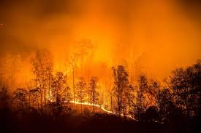
Project description
Twitter has become an important communication channel in times of emergency. The ubiquitousness of smartphones enables people to announce an emergency they ‘re observing in real-time.
Because of this more agencies are interested in programmatically monitoring Twitter( i.e. Disaster relief organizations news agencies)
So, the challenge is to develop a machine learning model capable of accurately classifying tweets as related to real disasters or not. The nuanced and context-dependent nature of tweets, where terms like “fire” or “flood” may be used metaphorically, adds complexity to the task. The model must reliably discern the true intent behind the language used.

Slide 3
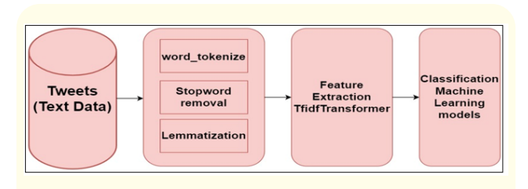
Steps to follow for NLP

Slide 4
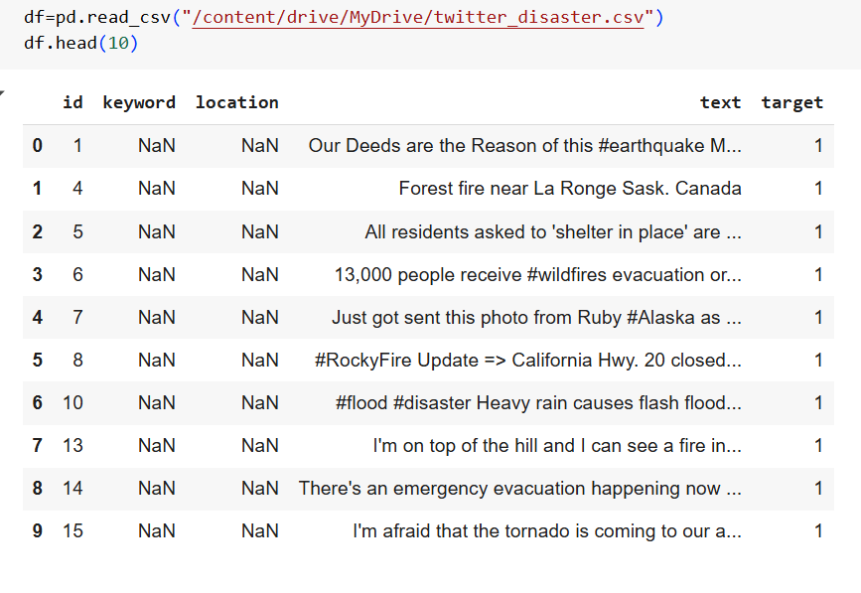
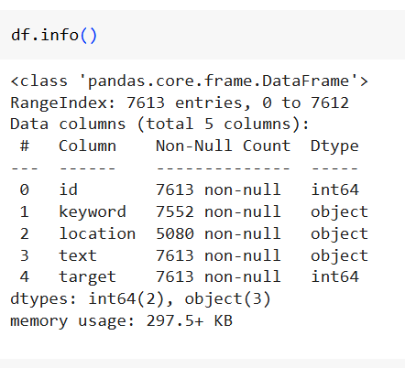
Data overview
#libraries for NLP
import nltk
import re
from nltk.corpus import stopwords
from collections import Counter
From sklearn.feature_extraction.text
import TfidfVectorizer
from nltk.stem.porterimportPorterStemmer
From nltk.stem.snowball import
SnowballStemmer etc.
From sklearn.ensemble
import,VotingClassifier,
RandomforestClassifier

Slide 5
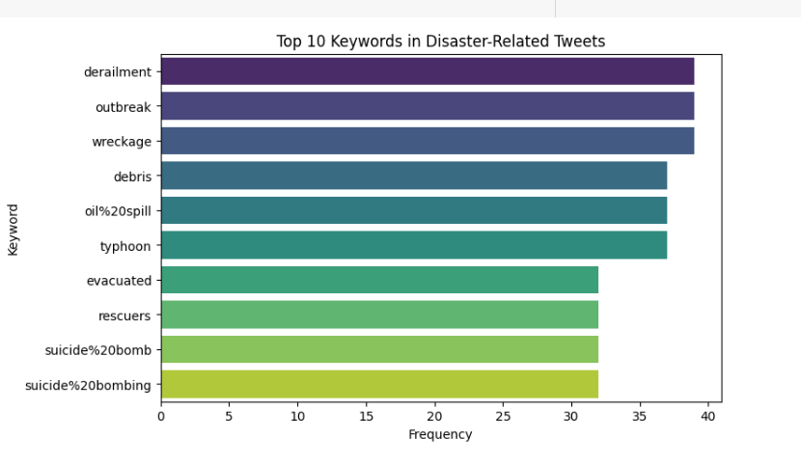
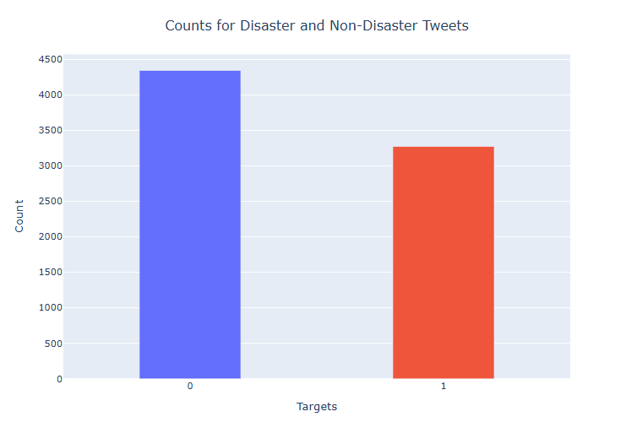
Exploratory data analysis * Top 10 keywords in Disaster related tweets. *Count for Disaster and non disaster Tweets( non Disaster tweetes are greater then disaster tweets )

Slide 6
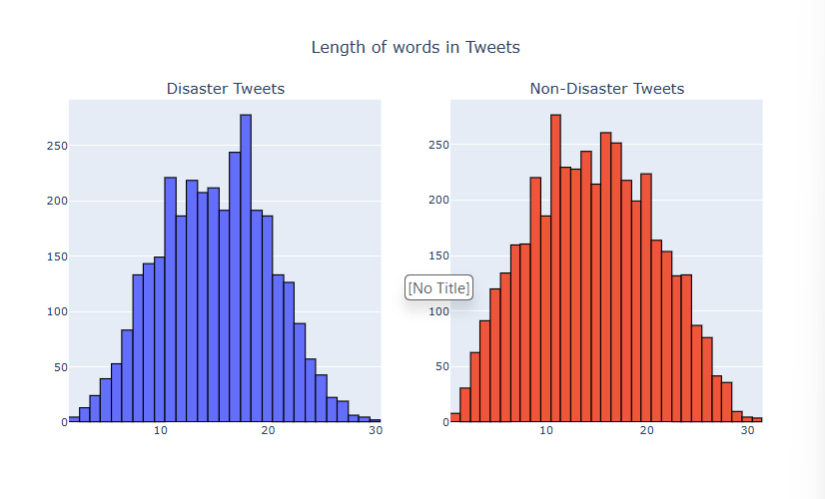
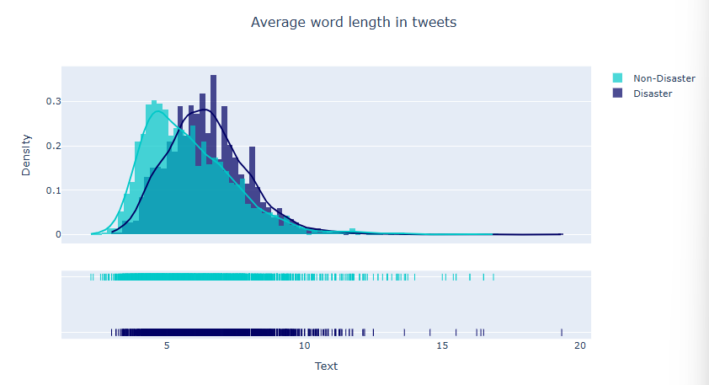
Visualizing Length of Disaster tweets and non disaster tweets
Average word length of tweets

Slide 7
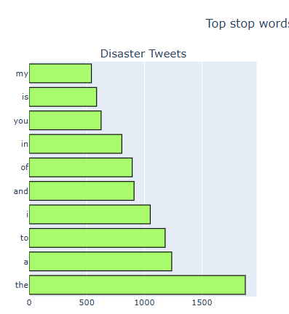
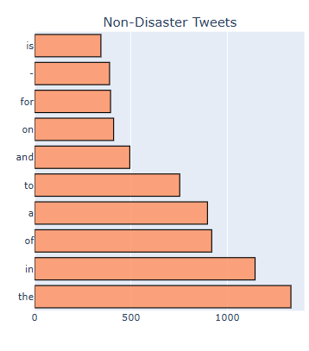
Top stop words in text
Disaster Tweets ‘top stop word
Non-Disaster Top stop words

Slide 8
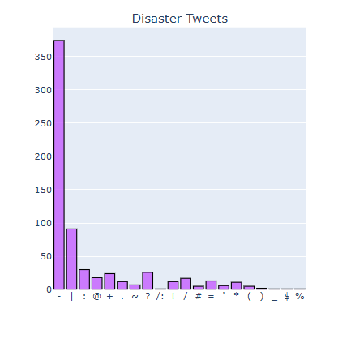
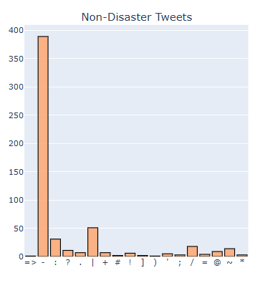
TOP PUNCTUATION IN THE TEXT
Disaster tweets
Non-Disaster tweets

Slide 9
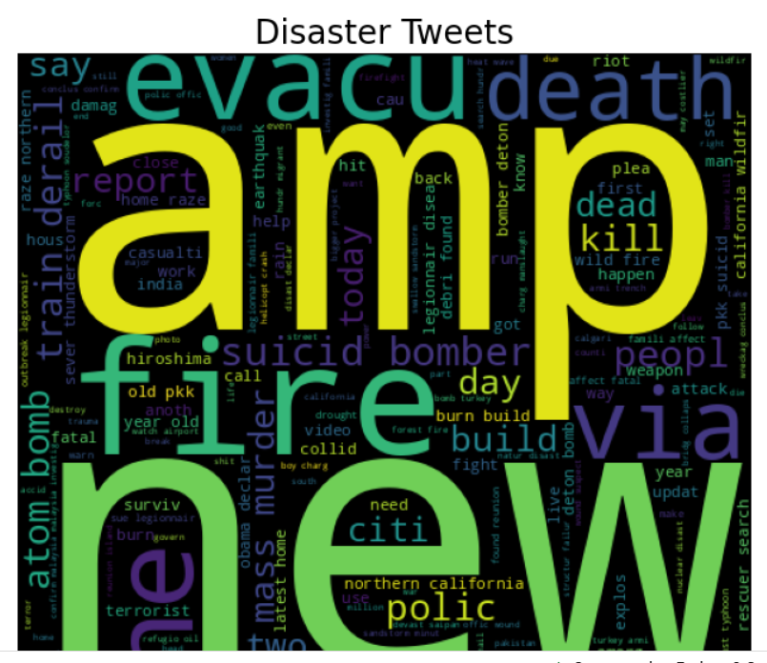
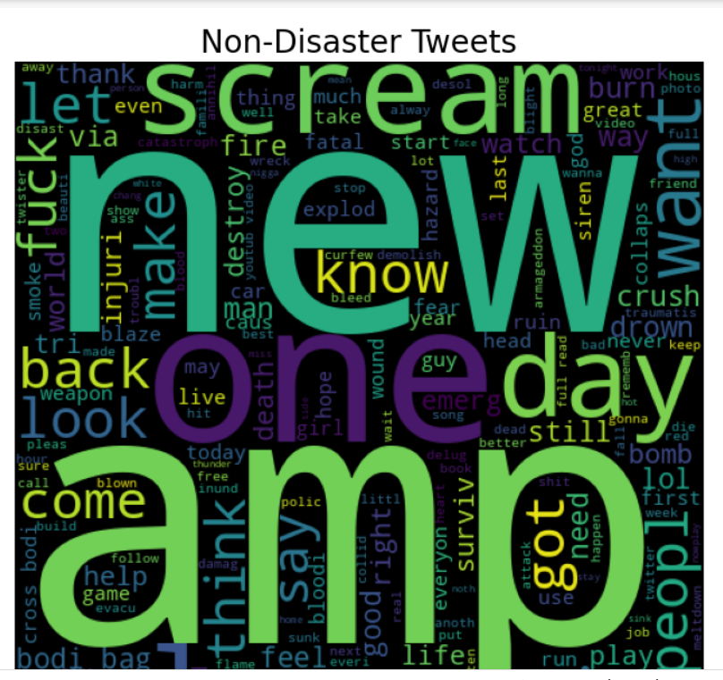
Visualizing words inside Real Disaster Tweets
Real Tweet words
wordcloud
Fake Tweet words
wordcloud

Slide 10
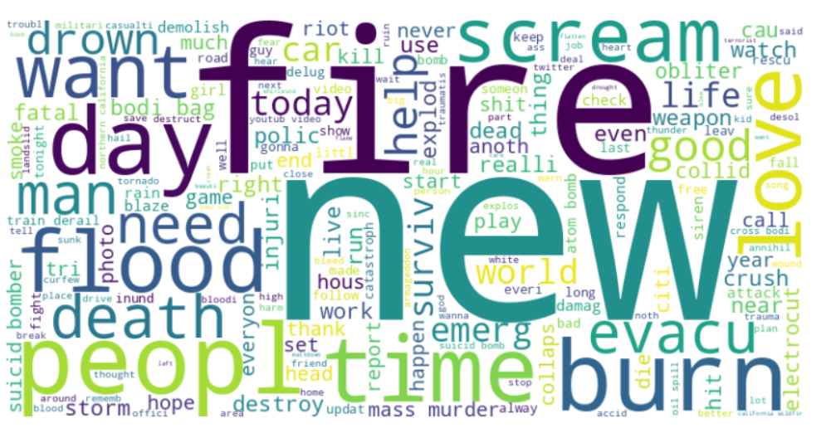
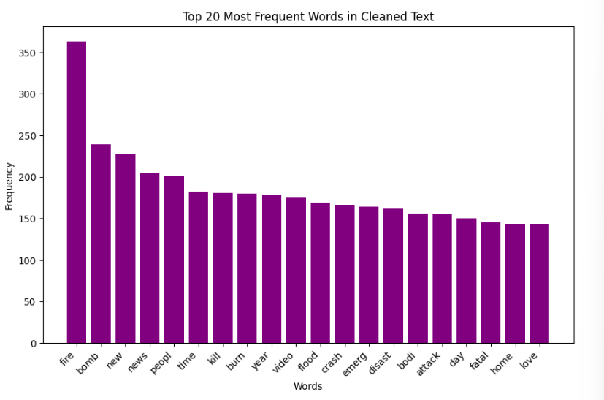
Cleaned text cloud

Slide 11
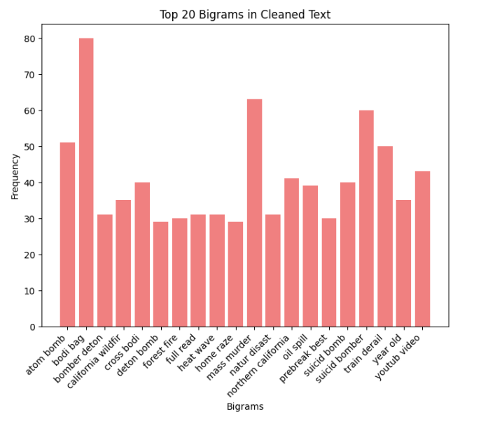
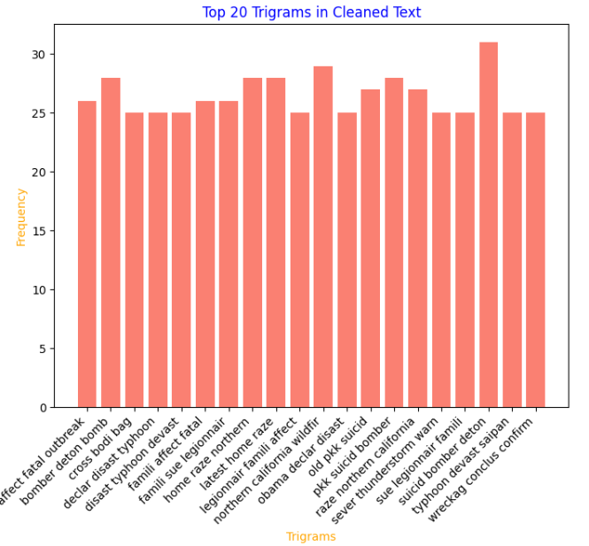
Bigram or Trigram Visualization
Top 20 Bigrams in cleaned text
Top 20 Trigram in cleaned text

Slide 12
Data Preprocessing
Data Encoding using BOW or TF-IDF
@ What is BoW?
BoW stands for "bag of words" which is a representation of text that describes the occurrence of words within a document.We just keep track of word counts and disregard the grammatical details and the word order.It is called a “bag” of words because any information about the order or structure of words in the document is discarded. The model is only concerned with whether known words occur in the document, not where in the document.
@ What is TF-IDF?
TF-IDF which means Term Frequency and Inverse Document Frequency, is a scoring measure widely used in information retrieval (IR) or summarization.TF-IDF is intended to reflect how relevant a term is in a given document. It is a technique in Natural Language Processing for converting words in Vectors and with some semantic information and it gives weighted to uncommon words , used in various NLP applications.For BoW approach we use scikit-learn's CountVectorizer and for TF-IDF we use TfidfVectorizer

Slide 13
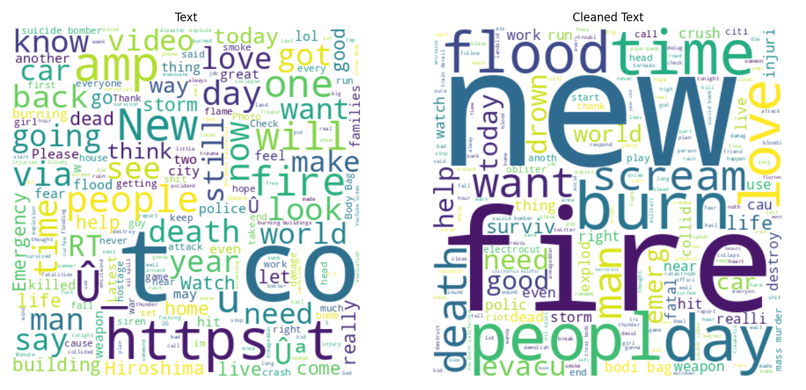
View of cleaned text after Preprocessing

Slide 14
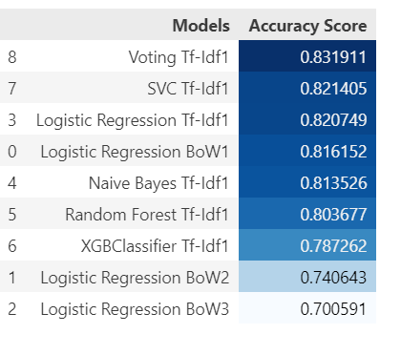
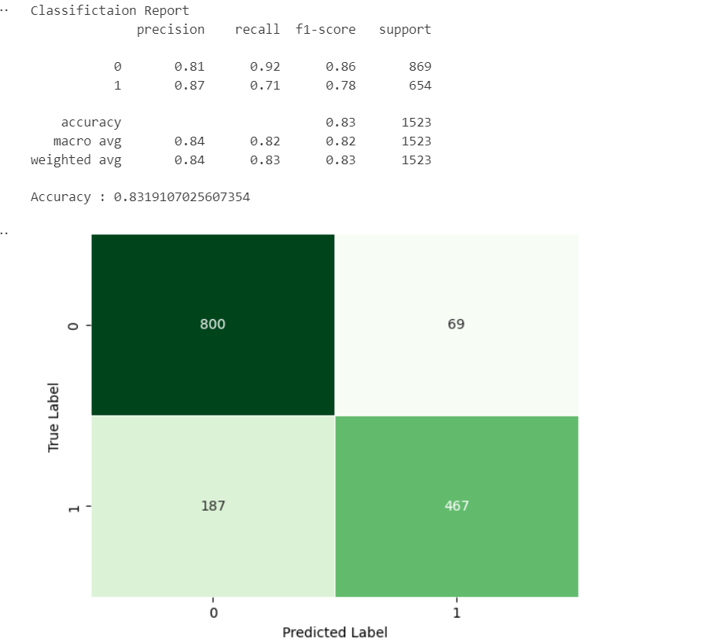
MODEL BUILDING USING CLASSIFICATION ALOGRITMS using n-grams to find out best model through Classification Report
Voting classifier gives the best accuracy (83 %) among all. The voting classifier is an ensemble learning technique used in machine learning to improve the performance of a model by combining the predictions of multiple individual models (classifiers). The main purposes and benefits of the voting classifier include: Improved accuracy , Robustness, Reduction of overfitting etc. Now we can predict real tweets on the basis of finally trained model.
Following algorithms are tried to get robust model for prediction :-
1.Logistic Regression,
2.Multinomal NB
3.Random Forest classifier
4.eXtreme Gradient 5.Boosting Classifier
6.SVC
7.Voting Classifier

Slide 15

This Photo by Unknown Author is licensed under CC BY-SA

